Slide 1

6th Grade Accelerated Math
Unit 15, Lesson 3 Probability Volume 2, pg. 411

Slide 2


Benchmarks
MA.7.DP.2.2
Given the probability of a chance event, interpret the likelihood of it occurring. Compare the probabilities of chance events.
MA.7.NSO.1.2
Rewrite rational numbers in different but equivalent forms including fractions, mixed numbers, repeating decimals, and percentages to solve mathematical and real-world problems.
volume 2, pg. 411

Slide 3
Integrated Mathematical Thinking and Reasoning Standards
MA.K12.MTR.2.1 Demonstrate understanding by representing problems in multiple ways.
MA.K12.MTR.3.1 Complete tasks with mathematical fluency.
volume 2, pg. 411

Slide 4

Learning Targets
I can express the probability of a chance event using a fraction, percentage, or decimal.
I can compare probabilities of chance events.
volume 2, pg. 411

Slide 5

Warm-Up
volume 2, pg. 411

Slide 6
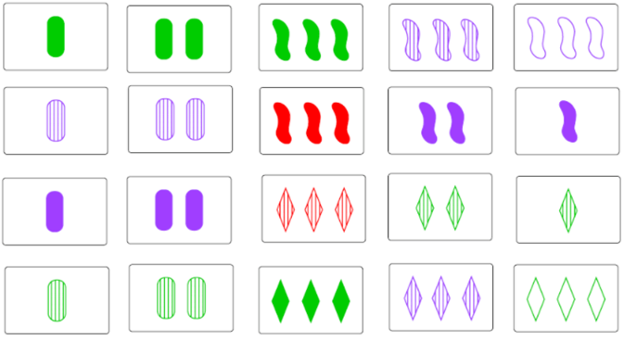
15.3.1 Warm-Up: Notice and Wonder
Some of the cards in the card game SET are shown.
volume 2, pg. 411

Slide 7
What do you notice?
What do you wonder?
volume 2, pg. 411

Slide 8

Exploration
volume 2, pg. 412

Slide 9

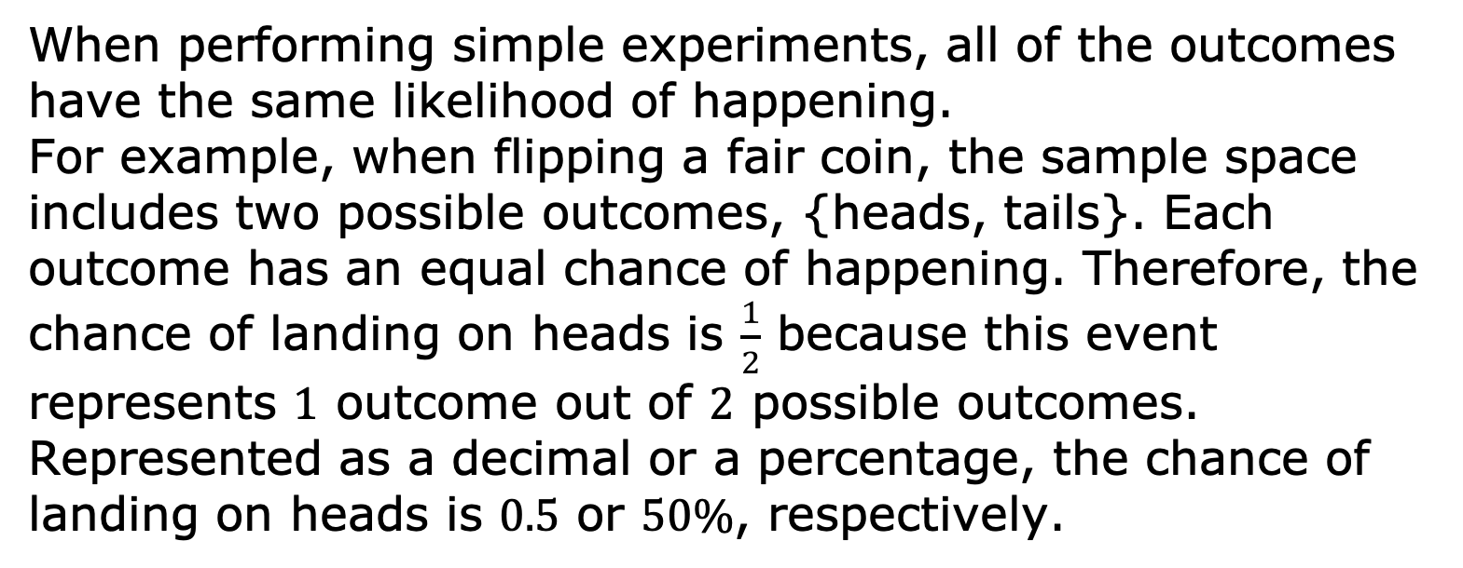
15.3.2 Exploration: Representing Probabilities
When performing simple experiments, all of the outcomes have the same likelihood of happening. For example, when flipping a fair coin, the sample space includes two possible outcomes, {heads, tails}. Each outcome has an equal chance of happening. Therefore, the chance of landing on heads is $\frac{1}{2}$ because this event represents $1$ outcome out of $2$ possible outcomes. Represented as a decimal or a percentage, the chance of landing on heads is $0.5$ or $50\%$, respectively.
volume 2, pg. 412

Slide 10
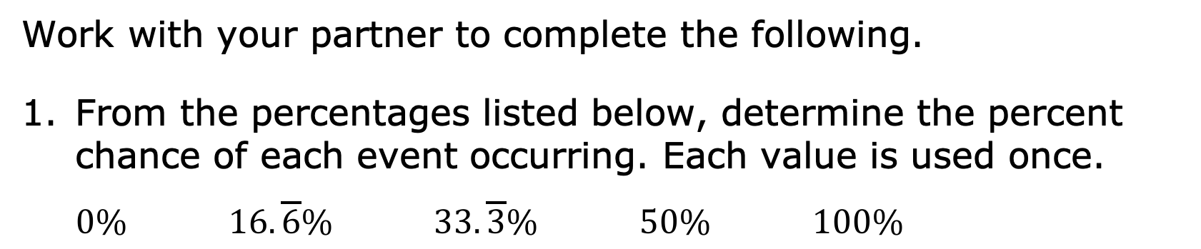
Work with your partner to complete the following.
From the percentages listed below, determine the percent chance of each event occurring. Each value is used once.
$0\%$ $16.\overline{6}\%$ $33.\overline{3}\%$ $50\%$ $100\%$
Event | Percent Chance
When given three doors with only one containing a prize behind it, what is the chance of opening the prize-winning door?
When reaching into a dark closet with five pairs of shoes, what is the chance of pulling out a left shoe?
volume 2, pg. 412

Slide 11
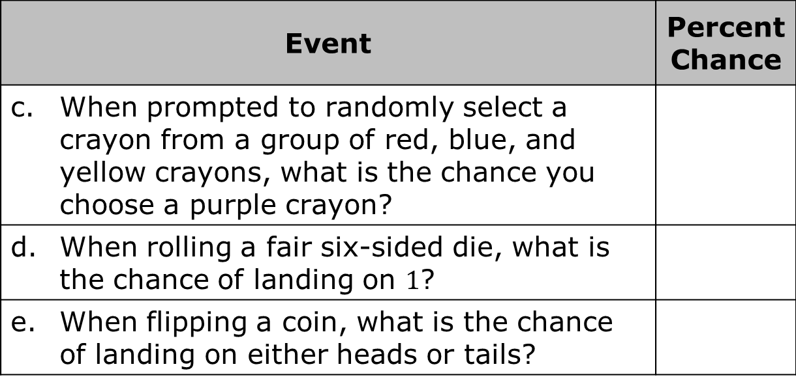
Event | Percent Chance
When prompted to randomly select a crayon from a group of red, blue, and yellow crayons, what is the chance you choose a purple crayon?
When rolling a fair six-sided die, what is the chance of landing on $1$?
When flipping a coin, what is the chance of landing on either heads or tails?
$0\%$ $16.\overline{6}\%$ $33.\overline{3}\%$ $50\%$ $100\%$
volume 2, pg. 412

Slide 12
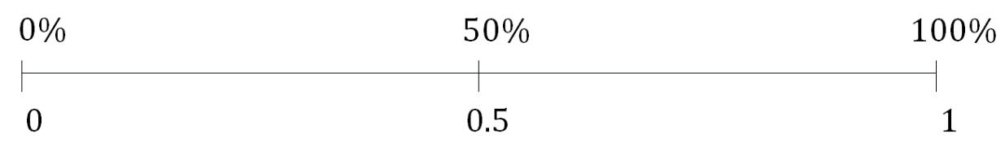

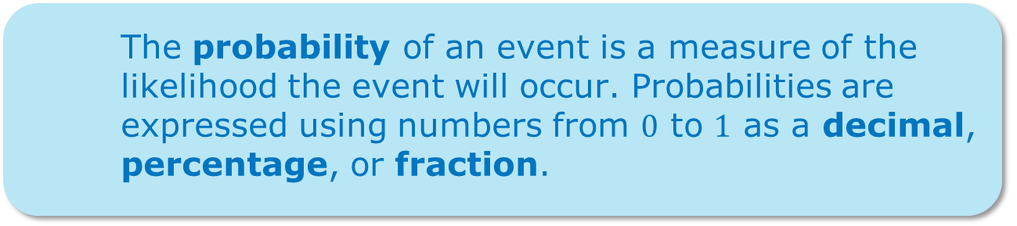
Plot and label a point to represent the percent chance of each event happening from the previous question. Use the letters labeling each event.
Consider the event from question 1 that is least likely to occur.
Which event is the least likely to happen?
The probability of an event is a measure of the likelihood the event will occur. Probabilities are expressed using numbers from $0$ to $1$ as a decimal, percentage, or fraction.
volume 2, pg. 412

Slide 13
Describe, using sentences, the likelihood of this event happening.
Discuss with your partner whether or not it is possible to have a probability less than this.
Consider the event from question 1 that is most likely to occur.
Which event is the most likely to occur?
volume 2, pg. 412-413

Slide 14
Describe, in sentences, the likelihood of this event happening.
Discuss with your partner whether or not it is possible to have a probability greater than this.
Which event has the same likelihood of happening or not happening?
volume 2, pg. 413

Slide 15

Bring It Together
volume 2, pg. 413

Slide 16

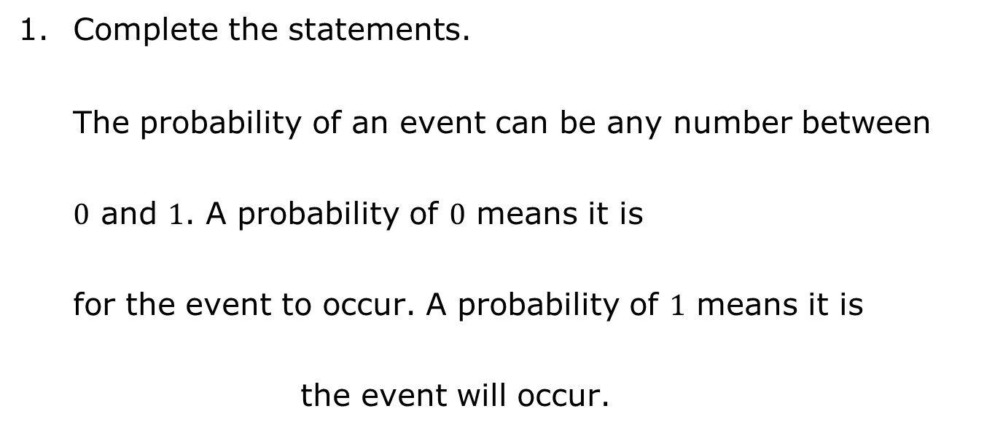
15.3.3 Bring It Together: Representing Probabilities
Complete the statements.
The probability of an event can be any number between $0$ and $1$. A probability of $0$ means it is for the event to occur. A probability of $1$ means it is the event will occur.
certain
impossible
certain
impossible
volume 2, pg. 413

Slide 17
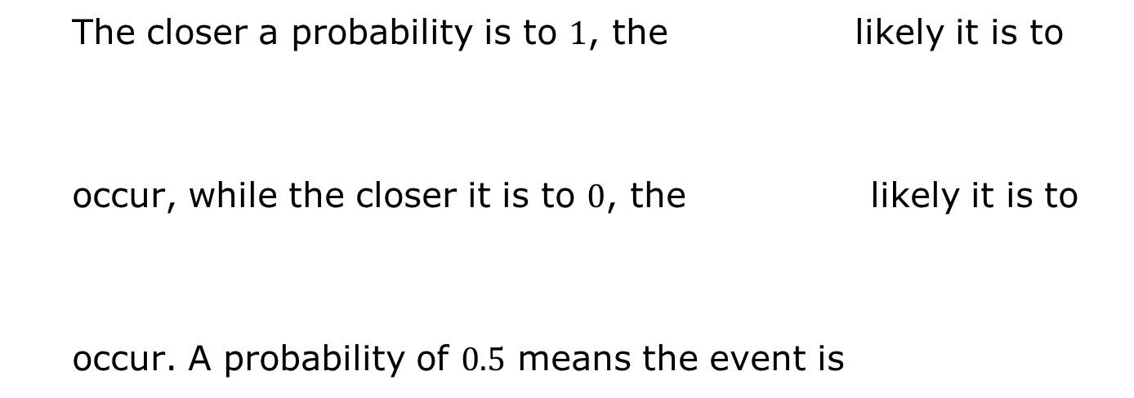
more
less
The closer a probability is to $1$, the likely it is to occur, while the closer it is to $0$, the likely it is to occur. A probability of $0.5$ means the event is
more
less
likely.
unlikely.
neither likely nor unlikely.
volume 2, pg. 413

Slide 18
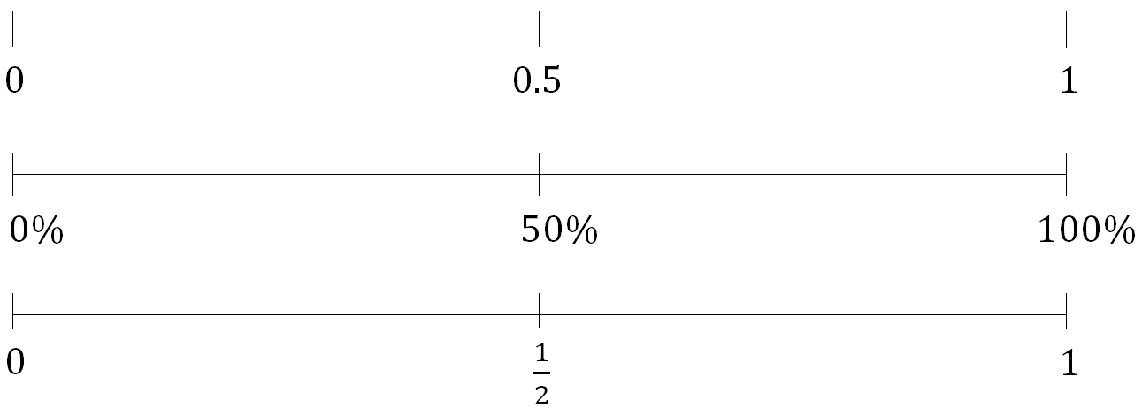
Probabilities can be represented by decimals, percentages, or fractions with equivalent values between $0$ and $1$.
volume 2, pg. 413

Slide 19

Guided Instruction
volume 2, pg. 414

Slide 20

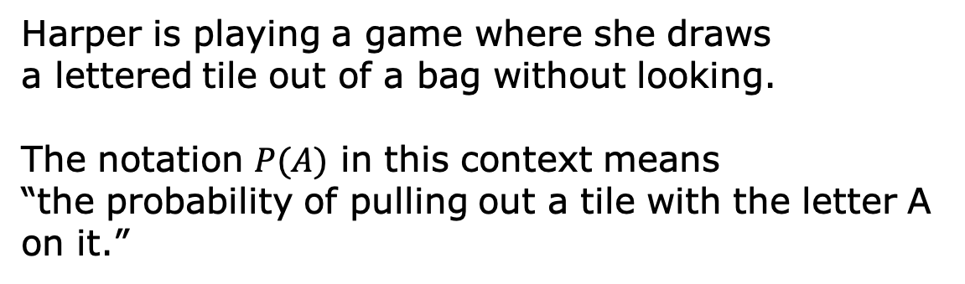
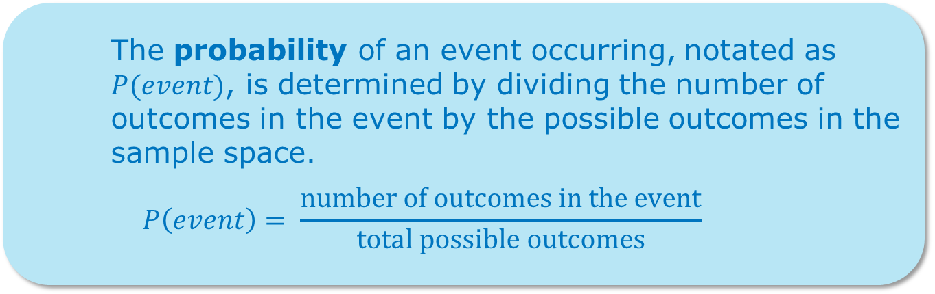
15.3.4 Guided Instruction: Expressing Probabilities of Events
The probability of an event occurring, notated as $P(event)$, is determined by dividing the number of outcomes in the event by the possible outcomes in the sample space.
$$P\left(event\right)= \frac{number of outcomes in the event}{total possible outcomes}$$
Harper is playing a game where she draws a lettered tile out of a bag without looking.
The notation $P(A)$ in this context means “the probability of pulling out a tile with the letter A on it.”
volume 2, pg. 414

Slide 21

Find the probability of each event, represented as a fraction.
a. $P$(A)
b. $P$(B)
c. $P$(M)
d. $P$(vowel)
e. $P$(letter)
volume 2, pg. 414

Slide 22
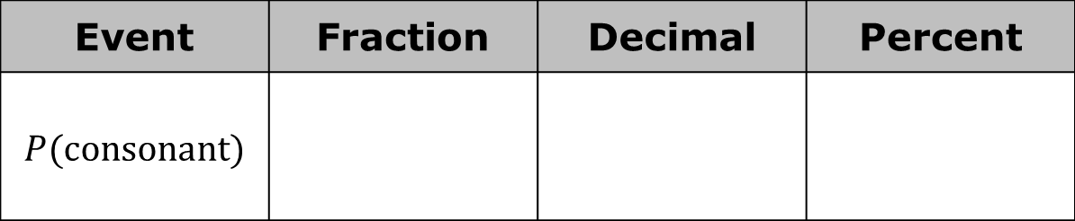
Consider the probability of pulling a tile with a consonant on it.
Complete the table to find the fraction, decimal, and percentage equivalents of the probability.
The probability of this event is a repeating decimal. When this occurs, the decimal or percentage representation is typically rounded.
Event | Fraction | Decimal | Percent
$P$(consonant)
volume 2, pg. 414

Slide 23
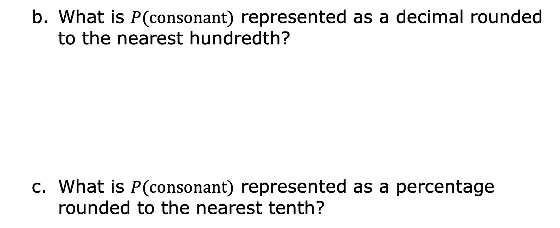
What is $P(consonant)$ represented as a decimal rounded to the nearest hundredth?
What is $P(consonant)$ represented as a percentage rounded to the nearest tenth?
volume 2, pg. 414

Slide 24

Try It
volume 2, pg. 415

Slide 25

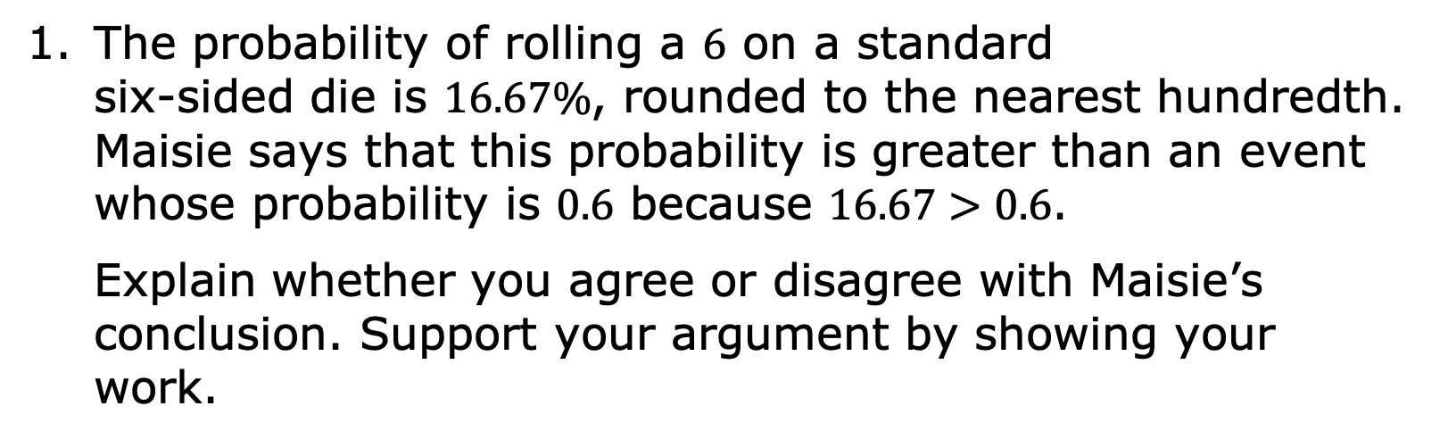
15.3.5 Try It: Expressing Probabilities of Events in Different Forms
The probability of rolling a $6$ on a standard six-sided die is $16.67\%$, rounded to the nearest hundredth. Maisie says that this probability is greater than an event whose probability is $0.6$ because $16.67>0.6$.
Explain whether you agree or disagree with Maisie’s conclusion. Support your argument by showing your work.
volume 2, pg. 415

Slide 26
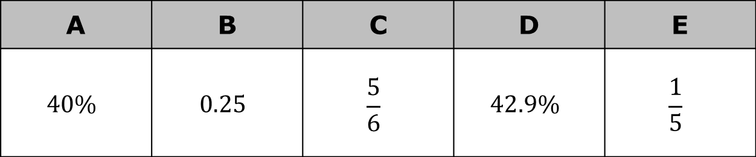
The probabilities of five events are given.
Order the values of the probabilities from least to greatest.
A | B | C | D | E
$$40\%$$ | $$0.25$$ | $$\frac{5}{6}$$ | $$42.9\%$$ | $$\frac{1}{5}$$
volume 2, pg. 415

Slide 27
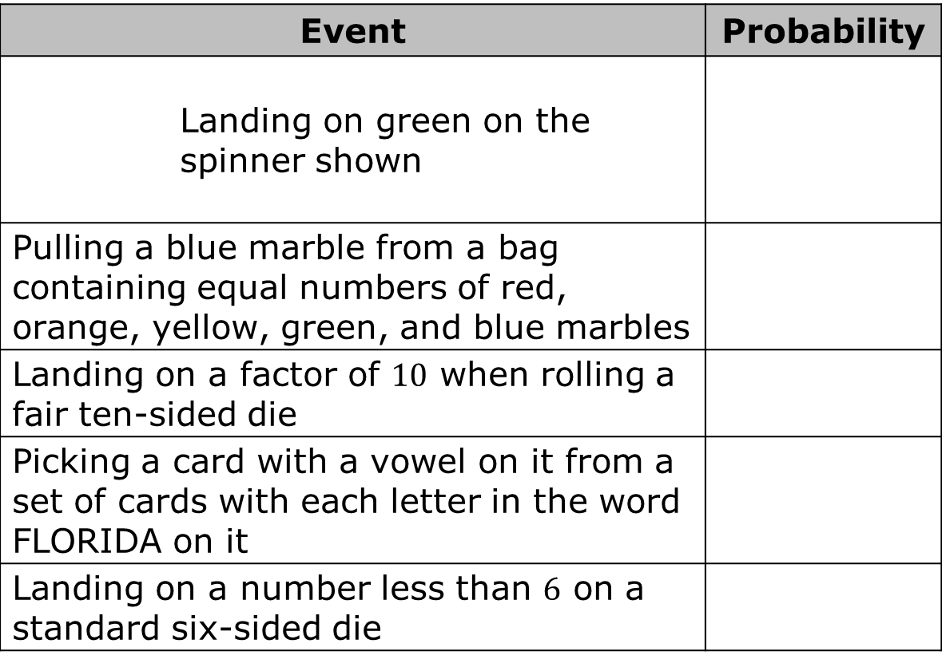
Match the probabilities with the events described in the table.
Event | Probability
Landing on green on the spinner shown
Pulling a blue marble from a bag containing equal numbers of red, orange, yellow, green, and blue marbles
Landing on a factor of $10$ when rolling a fair ten-sided die
Picking a card with a vowel on it from a set of cards with each letter in the word FLORIDA on it
Landing on a number less than $6$ on a standard six-sided die
volume 2, pg. 415

Slide 28
Explain which event is the least likely to occur based on the probabilities.
volume 2, pg. 415

Slide 29

Wrap-Up
volume 2, pg. 416

Slide 30
15.3.6 Wrap-Up: Reflection
Draw an X on each line to indicate where your current level of understanding is related to each target.
I can express the probability of a chance event using a fraction, percentage, or decimal.
I can compare probabilities of chance events.
I need help. I can’t get started. | I’m getting there, but I need more practice. | I understand this and I feel confident.
I need help. I can’t get started. | I’m getting there, but I need more practice. | I understand this and I feel confident.
volume 2, pg. 416

